Slide 1

Virtual Maths Question Bank
PERSONALIZED LEARNING FOR MIDDLE SCHOOL
Group:AUTOBOTS
Berat KAVRUT Bora PARALI Kerem YERKAZAN Tuna ÇALISKAN Yigit SHENODZHAK

Slide 2

The Idea and Problem
Math should not be scary
Most middle school students struggle with math because textbooks are boring and too hard. When a student fails, they lose confidence.
Virtual Math Bank is a free app that adjusts the difficulty in real-time. If you do well, it gets harder. If you struggle, it helps you improve.

Slide 3





Target Users
Students
Grades 5-8 looking for a free, fun way to practice math and earn points.
Teachers
Educators who need high-quality, free digital questions for their students.
Parents
Families who want to help their children learn math without expensive tutors.

Slide 4
Main Features
3
Difficulty Levels
10
Points per Answer
FREE
Zero Cost Access
Our System Logic enables a structured learning experience. Students can solve
comprehensive question sets while the system records performance
data for final session reports.

Slide 5

What is in Scope?
Category | Included (In-Scope) | Future (Out-of-Scope)
Curriculum | Middle School Math (Grades 5-8) | High School & University Level
Questions | Adaptive Difficulty System | Video Lectures or Tutors
Platform | Web-based Mobile Application | Printed Question Books
Gamification | Scoring and Progress Tracking | Real-money Rewards

Slide 6


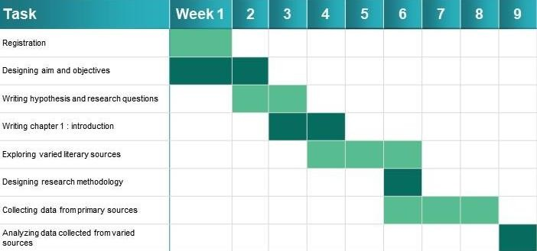
Project Plan
9-Week Roadmap
We followed a structured path from early research to final testing.
Weeks 1-3: System Design Weeks 3-7: Core Coding Weeks 7-9: Testing & Demo

Slide 7

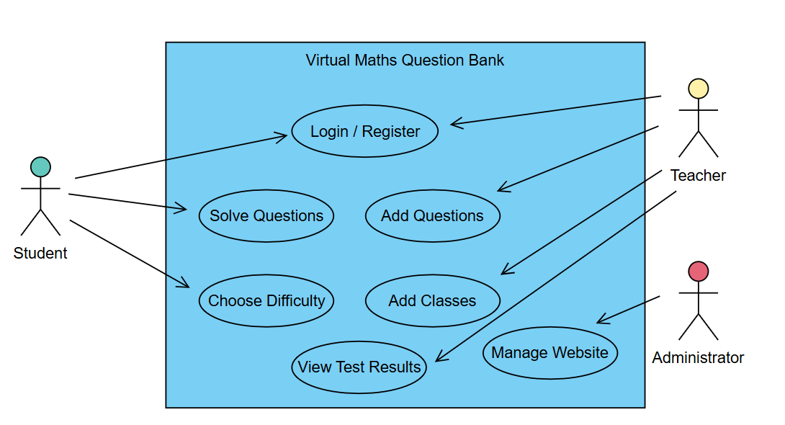
Use Case Diagram

Slide 8
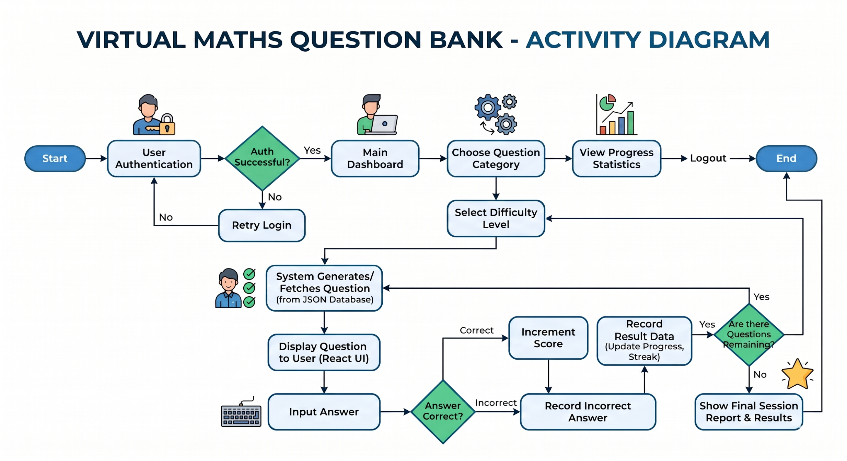
Activity Diagram

Slide 9
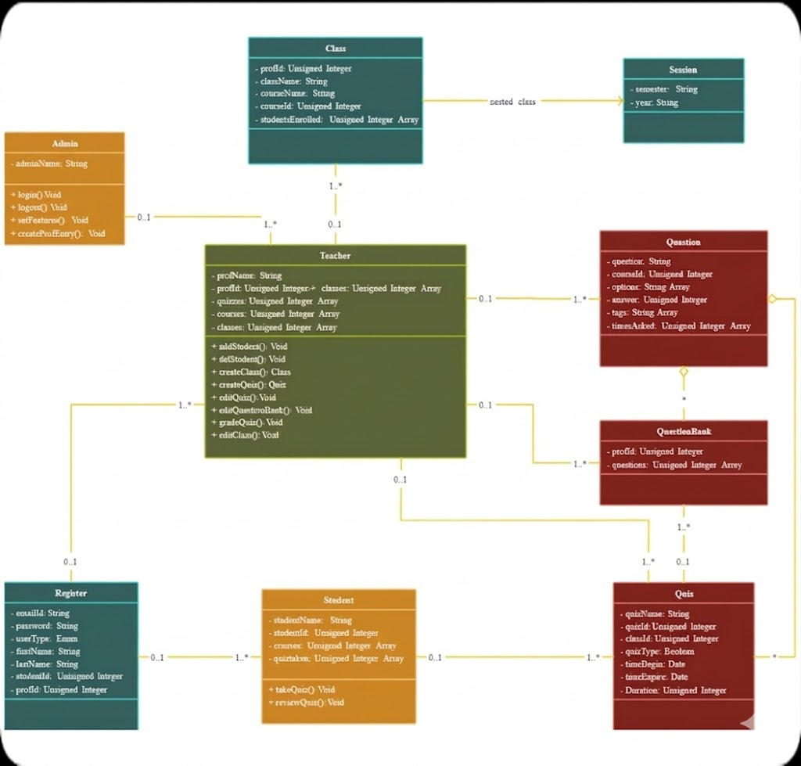
Class Diagram
OOP Architecture
The backbone of our software is built on clear
object-oriented principles.

Slide 10



Adaptive Workflow
1. Difficulty Level
User have to choose a difficulty level to start up.
2. Solving Test
Users who chose a difficulty level will start to solving the test.
3.Test Results
After finishing their test questions users will get a final point.

Slide 11

Live Demo
Experience the Virtual Maths Question Bank in action.

Slide 12
Status and Future
Current Status
Beta 1.0: All math categories for middle grade students are ready. Also teachers can upload question for their students.
Limitations: Currently needs internet to load questions. Every people who is using this website must sign in before starting to use.
Next Steps
Offline Mode: Download questions for home study.
Leaderboard: Compete with your classmates for high scores.
Prove: Teachers need to prove themselves to sign in as a teacher account. We need to make a contract with the education departments.

Slide 13
Engineering Journal
Key Decisions: We chose a dynamic difficulty manager over static levels to keep students
engaged longer.
Challenges: Balancing the "Hard" level so it is challenging but not impossible for middle grade students.
Contribution: Berat (Backend), Yigit (UI Design/Dev), Bora/Kerem (BA), Tuna (PM).
Progress: Completed 100% of planned features for the MVP.

Slide 14
Questions ?
We are ready to answer your questions about Virtual Maths Question Bank.
Berat - Bora - Kerem - Tuna - Yigit
Contact: autobotsege@gmail.com

Slide 15

Image Sources
https://parenting-passport.com/wp-content/uploads/2024/07/image-86.webp Source: parenting-passport.com

